Slide 1

.
.

Slide 2
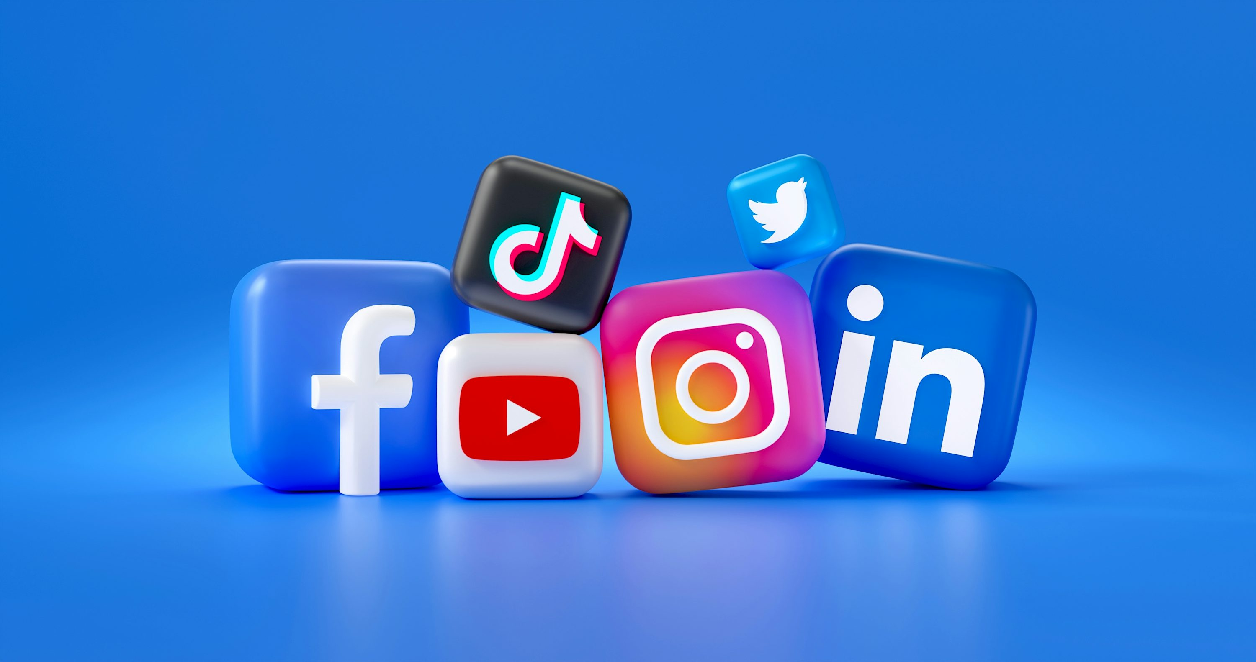
Social Media
Titel: Social Media - A Modern Necessity
Presented by: Muzammal Hussain, Sohaib and Zubair

Slide 3
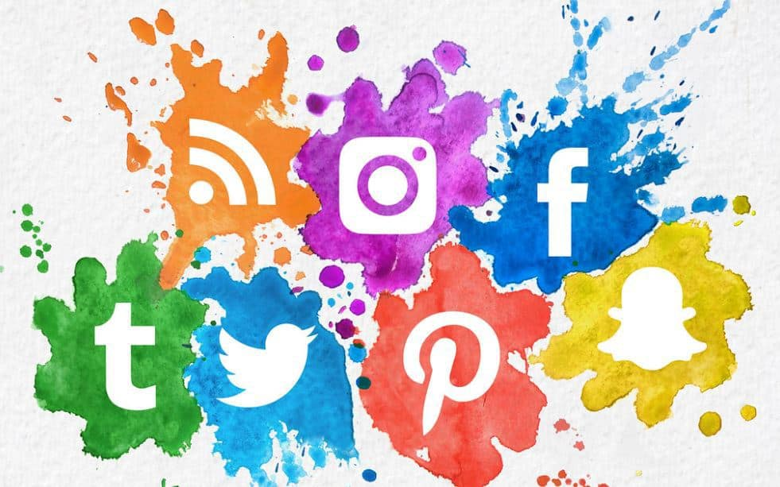
Social Media
What is Social Media?
Importance of Social Media
Pros and Cons of Social Media
Impact on Society

Slide 4

What is Social Media
Social media refers to online platforms where people connect, share information, and communicate.
Examples include Facebook, WhatsApp, YouTube, Instagram, and Twitter.

Slide 5
Importance of Social Media
Connectivity: It helps people stay connected with friends, family, and colleagues worldwide.
Instant Communication: Allows for quick sharing of news, ideas, and updates in real time.
Business Growth: Provides a platform for businesses to advertise, reach new customers, and build their brand.
Access to Information: Social media is a valuable source for news, trends, and learning.
Influence & Awareness: It's a powerful tool for raising awareness on important issues and creating social change.

Slide 6

Pros and Cons of Social Media
Pros:
✔ Easy connection with people worldwide.
✔ Business and learning opportunities.
✔ Quick access to news and updates.
Cons:
✖ Spread of fake news and misinformation.
✖ Privacy concerns and data security risks.
✖ Overuse can lead to time wastage.

